Slide 1







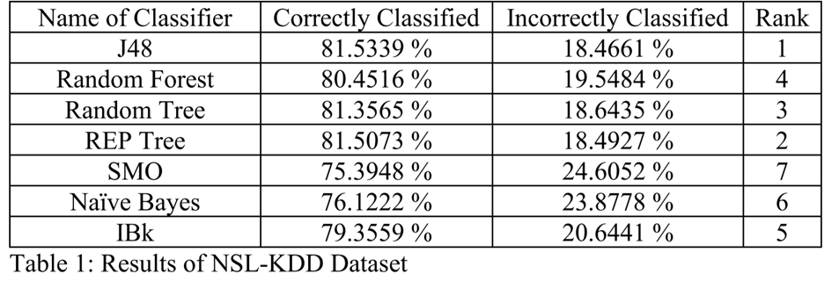
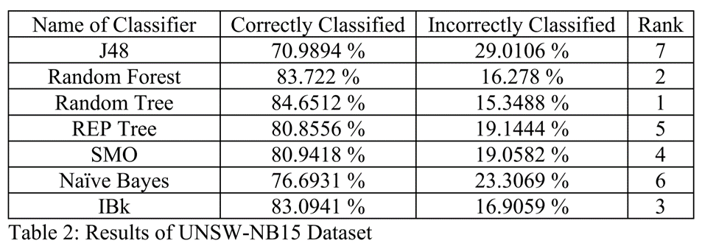
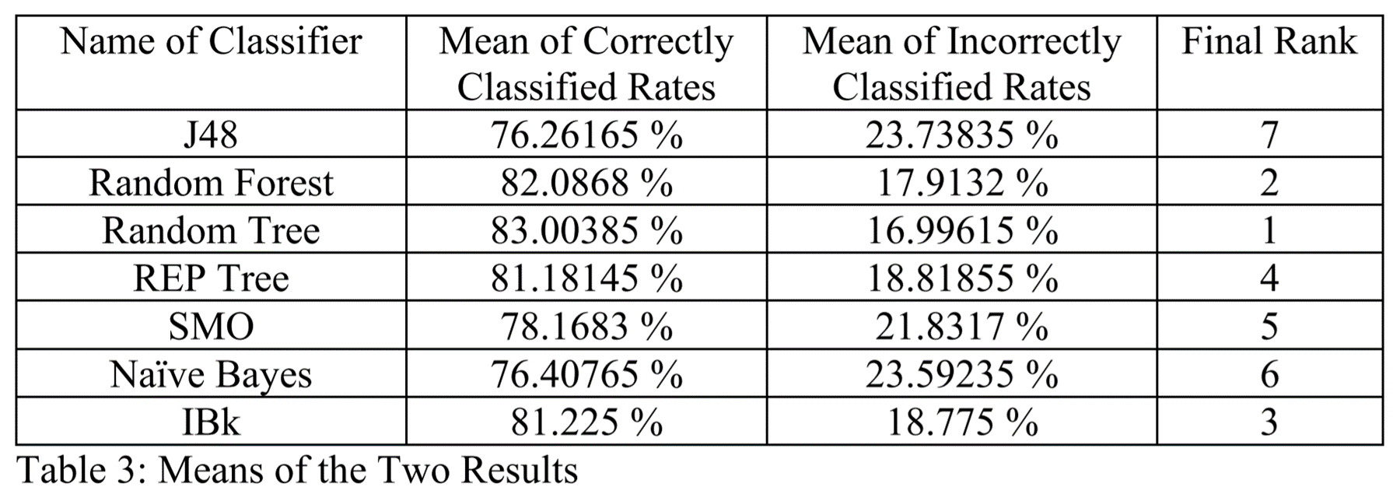
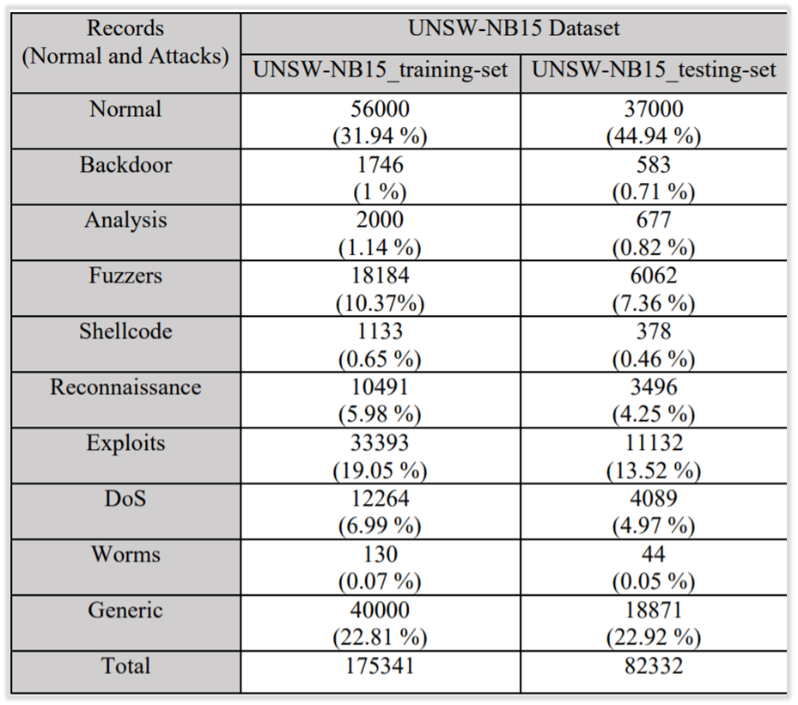
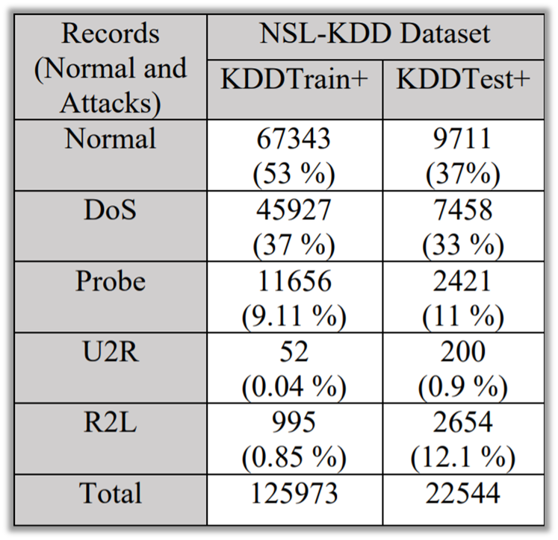
A Machine Learning Approach to Enhancing Intrusion Detection Systems
Noah Hassett and David Truong, Dr. David Anyiwo and Abiola Olanrewaju, Department of Management Information Systems
ABSTRACT
Together with many other disciplines, machine learning methods have been widely employed in intrusion detection systems (IDSs).
Currently, IDSs are widely used to protect networks and systems from increasing cyberattacks. → However, their high false-alarm rate is becoming a huge problem to keep the users’ information safe.
In this research, we used data mining software, WEKA 3.8.5, seven machine learning algorithms, J48, Random Forest, Random Tree, REP Tree, SMO, Naïve Bayes, and IBk, and two intrusion detection datasets, NSL-KDD and UNSW-NB15 to find the most accurate algorithm that could solve the problem of high false-alarm rate often associated with IDSs. From the tests we conducted, the Random Tree has the highest accuracy of all the seven algorithms. We expect that the findings of this study will contribute to the improvement of the performance of IDSs.
INTRODUCTION
Intrusion detection systems (IDSs) is a tool that can monitor and detect cyber-attacks
Three main detection mechanism: statistical method, data-mining method, and machine learning method.
Problem: High false alarm rate
according to a computer scientist, Tadeusz Pietraszek (2004), 99% of alerts reported by IDSs do not involve cybersecurity issues
Question: How effective are various machine learning algorithms in ensuring network security and enhancing IDSs?
Our research is going to focus on one of the most powerful mechanisms in IDS, the machine learning method, to solve the IDS problem
Machine Learning → a field of study that gives computers the ability to learn and improve from experience without the need of being programmed.
The machine learning-based IDS can achieve satisfactory detection levels when sufficient training data is available, and machine learning models have sufficient generalizability to detect attack variants and novel attacks.
Research Goal: Find the most accurate machine learning algorithm that can increase intrusion detection systems efficiency through automation
WEKA 3.8.5
a visualization tool that can be used for data preparation, classification, regression, clustering, and association
has various machine learning algorithms
Machine Learning Algorithms we used
Tree-Based: J48, Random Forest, Random Tree, REP Tree
Support Vector Machines: Sequential Minimal Optimization (SMO)
Bayes: Naïve Bayes
K-Nearest Neighbors: IBk
RESULTS
To check the accuracy of the seven classifiers, we loaded the training datasets in WEKA and ran the classifiers by supplying each testing dataset of the intrusion detection datasets that we chose. The results are below.
METHODS
Collect relevant data and datasets from Galileo, IEEE and other online databases
Understand, clean, and organize the datasets we found by using Microsoft Excel
identify the datasets by using machine learning algorithms in data analytics tool, WEKA 3.8.5
NSL-KDD Three Best Classifiers (Correctly Classified)
J48 – 81.5339 %
REP Tree – 81.5073 %
Random Tree – 81.3565 %
UNSW-NB15 Three Best Classifiers (Correctly Classified)
Random Tree – 84.6512 %
Random Forest – 83.722 %
IBk – 83.0941 %
Overall Results
To determine the overall results, we calculated the mean of each classifier’s results that we obtained by running the classifiers on the NSL-KDD and UNSW-NB15 datasets.
Intrusion Detection Datasets
NSL-KDD Dataset
has been developed to solve the problems of another IDS dataset KDD’99
→ huge number of duplicate packets
approximately 78% and 75% of the network packets of KDD’99 are duplicated in both the training and testing dataset
NSL-KDD dataset has much lower numbers of records than KDD’99
→ No duplicate records
Four different types of attacks: DoS, Probe, U2R, and R2L
the train dataset of NSL-KDD contains 125,973 records of normal and attack
the test dataset contains 22,544 records of normal and attack
UnSW-NB15 Dataset
a public dataset that encompasses normal and malicious records
developed by the University of New South Wales
Nine different types of attacks: DoS, Backdoor, Analysis, Fuzzers, Shellcode, Reconnaissance, Exploits, Worms, and Generic
The train dataset contains 175,341 records
The test dataset contains 82,332 records
CONCLUSION
Random Tree achieved the highest accuracy rate
Recommend to use this algorithm to create an accurate IDS
Future Research
Research more types of machine learning algorithms
Develop an efficient machine learning algorithm that integrates threat intelligence into intrusion detection systems to increase their efficiency through automation
ACKNOWLEDGEMENTS
Bowie State University
National Science Foundation
Dr. David Anyiwo
Mr. Abiola Olanrewaju

